Slide 1
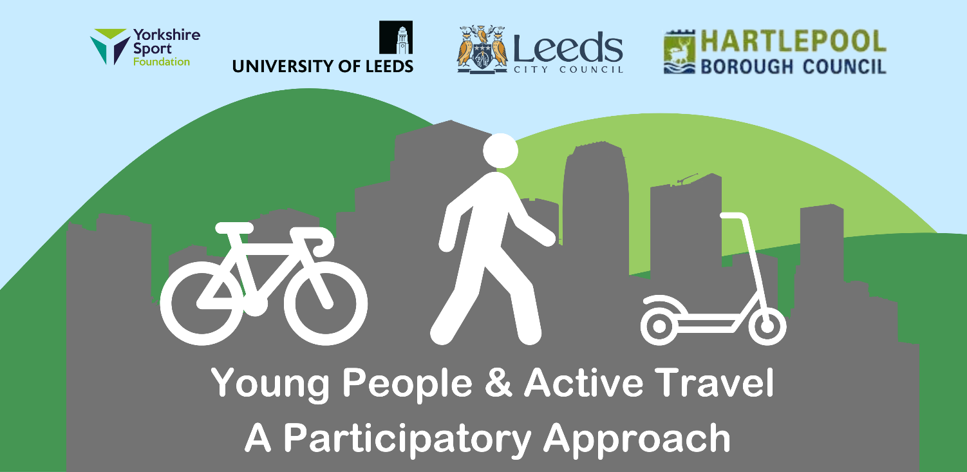
Dr Peter Hart (Education); Dr Morgan Campbell (ITS)

Slide 2
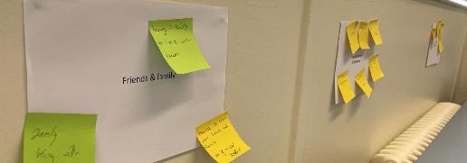
WELCOME!
Dr Peter Hart
Will Greenwood
Activetravel@leeds.ac.uk
Dr Morgan Campbell – Institute for Transport Studies, Sustainable Travel
Dr Kate Cameron
Laura Cunliffe – Student Services
Maria Gellar – Law, Laidlaw Scholar
Rebecca Hamer – Law, Laidlaw scholar
Agenda:
About Our Toolkit
Hearing from Hartlepool
Drawing Inspiration
Finish/networking

Slide 3
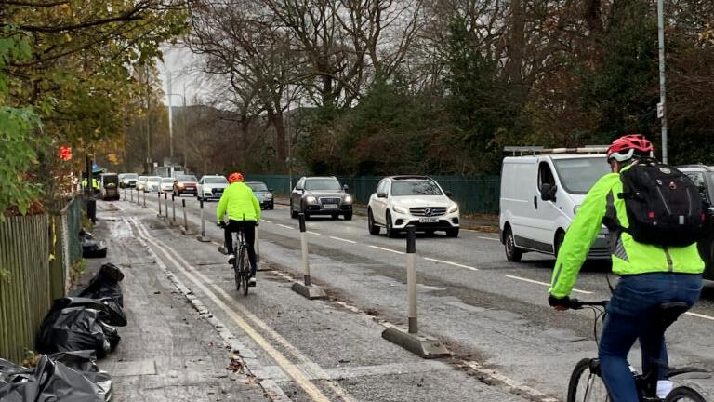
What is ‘active travel’?
“Active travel” means getting from A to B by any physically active means such as walking, cycling, kick scooting or skateboarding.
Do buses count?
Distinct from sustainable travel
This Photo by Unknown Author is licensed under CC BY

Slide 4

How do we gather young people’s voices during adult led discourses?

Slide 5
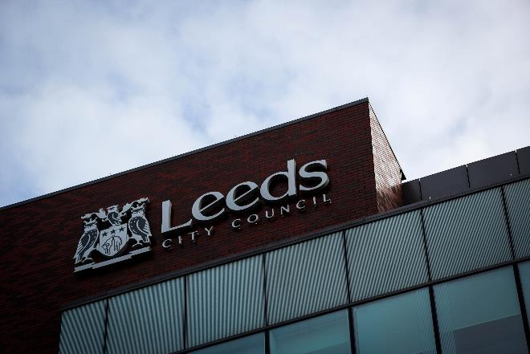
Background to the project
Yorkshire Sport Foundation & Leeds City Council:
Could young peoples’ journeys occasionally or routinely be done by ‘active travel’?
Could organisers of clubs / activities do anything differently to make it easier for young people to get there independently?

Slide 6
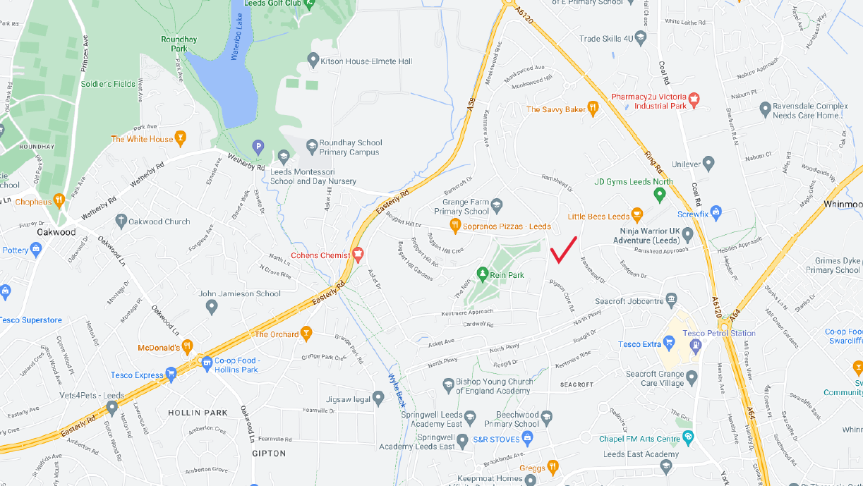
Initial aims
Conduct a ‘mapping’ exercise (Kallio 2015) to:
  Recruit peer researchers
  Understand ‘important spaces’ for young people
Train peer researchers (Bradbury and Taylor 2015)
Develop a methodology with peer researchers
Peer researchers collect data on specific barriers to active travel.

Slide 7
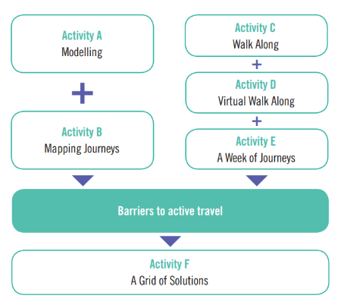


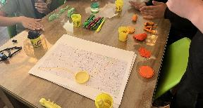
How we created the kit
Trialed with three organisations
Focus on one organisation
Key principles:
Young people as experts
Young people influence the environment
Young-person led

Slide 8
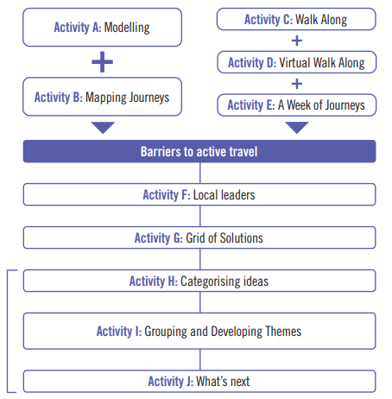
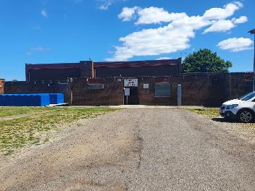
How we improved the kit
With Throston Youth Project, Hartlepool
Key principles:
Same as before, but….
Youth workers/practitioners need to find the kit useful

Slide 9
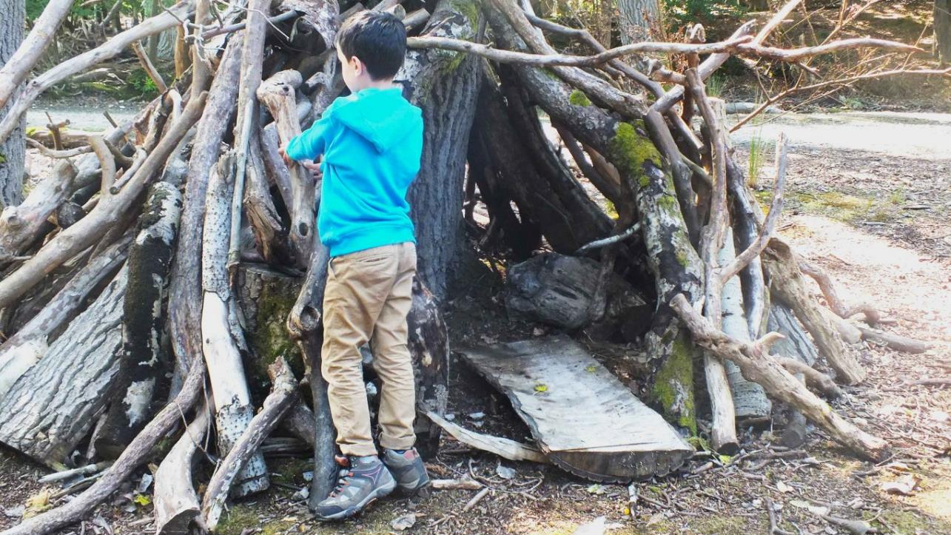
Why participation
What spaces has special significance when you were young?

Slide 10
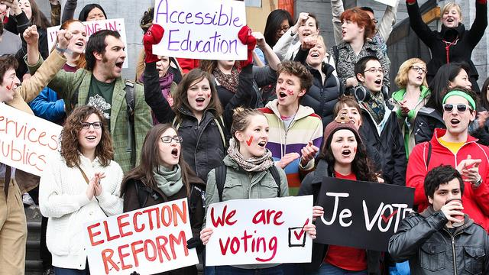
Political Presence as the Right of the Child
By appreciating children as constituting subjects and actors constitutive of their lived worlds, we may identify new forms, directions, dynamics and relations with political relevance…I propose children’s agency as a crucial component in spatial socialisation, involving both individual capacity to relate to the world and collective competence in intersubjective engagement.
(Kallio 2014)
That is: Young people have a right to be heard; young people are making decisions.
This Photo by Unknown Author is licensed under CC BY-NC

Slide 11

Why Participatory Action Research
Why use a toolkit instead of just asking?
We don’t always know what we want or need:
  Time to reflect
  Scaffolding potential answers
  Exploring and filling gaps in knowledge

Slide 12

Some assumptions:
Young people are experts in their own lives
Young people experience the world differently to adults
It can be difficult for young people to be heard in adult-led conversations
Many in power assume young people have little to contribute

Slide 13

A few notes on how to use the toolkit
Adapt it!
But keep the structure
Lead the process, not the conversation

Slide 14
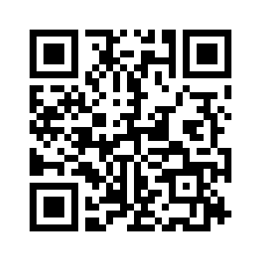
Visit out website for more
& please contribute!
https://www.activetravel.leeds.ac.uk

Slide 15
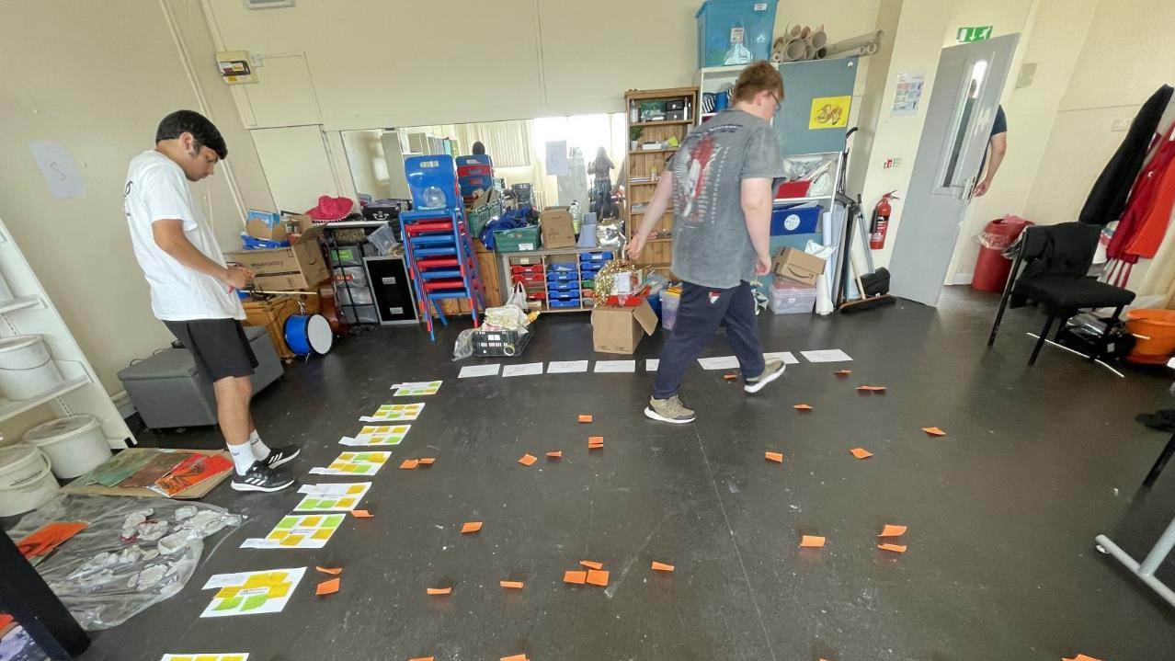
Any questions?
Activetravel@leeds.ac.uk
@ActiveTravelLDS

