Slide 1
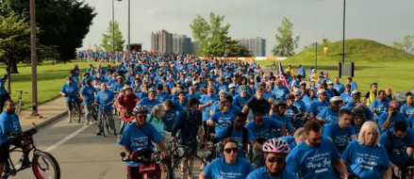
Mobility justice & why it is important for young people
Image: Detroit Free Press 2015
Morgan Campbell
University of Leeds
Sustainability Research Institute

Slide 2
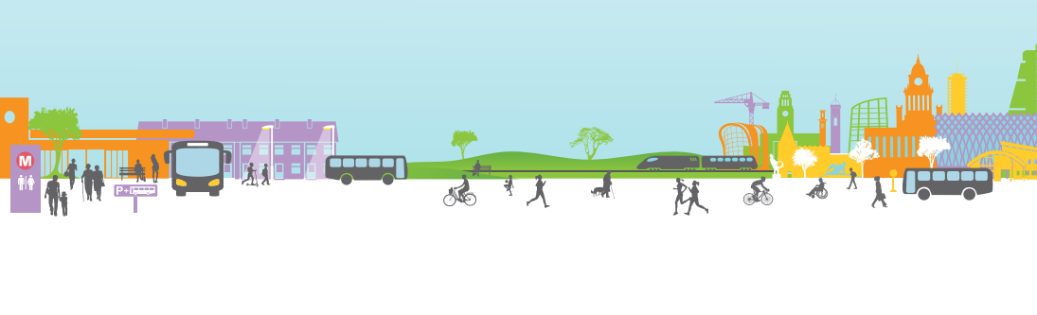
Active Travel
Making journeys—usually shorter, everyday trips—in physically active ways
Gains prominence in 2020 in response to several crises
  COVID
  Decarbonisation and long-term climate commitments
  Physical and mental health
  Improve quality of built environment
Active Travel England established 2022
Image: Connecting Leeds Report

Slide 3
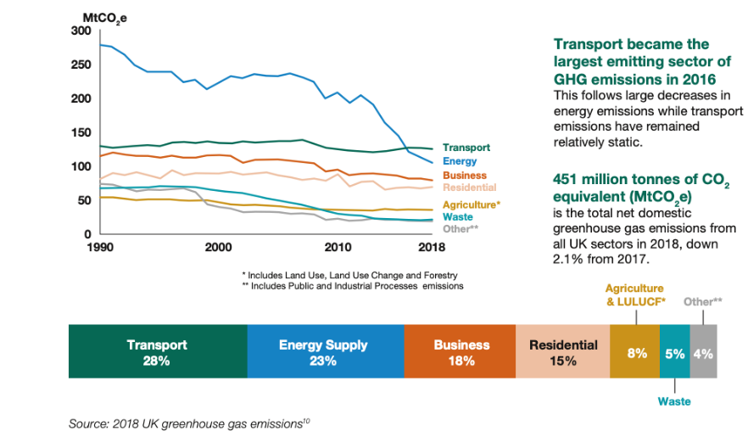
Transport and the climate emergency
https://assets.publishing.service.gov.uk/government/uploads/system/uploads/attachment_data/file/932122/decarbonising-transport-setting-the-challenge.pdf

Slide 4
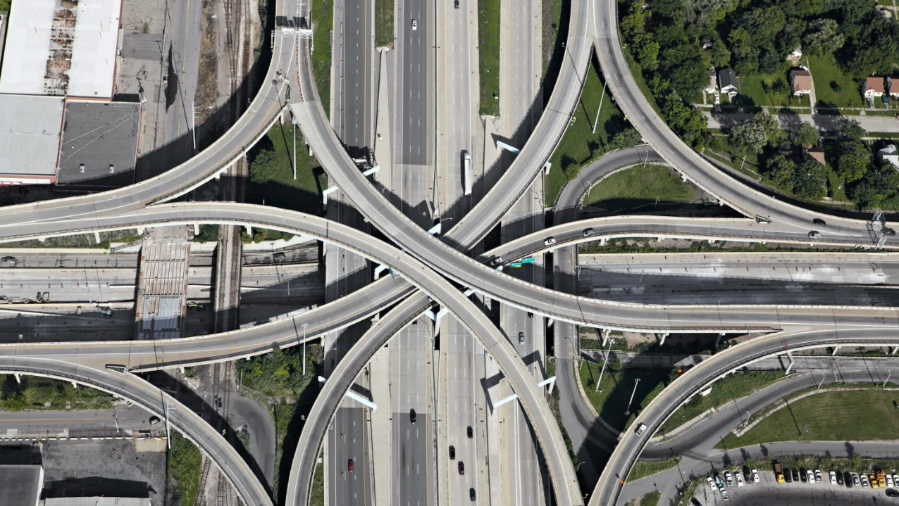
Automentality
Image: https://www.wired.com/2013/07/peter-andrew-aerial-freeways/

Slide 5

Automentality is real
The way in which nations cater to the car through implicit and explicit neoliberal policies, political economy, spatial planning, lobbies etc...(see Walks 2014)
It’s why the bus or train is more expensive than driving in Leeds
It’s the fact that every other commercial is for a car
It’s the reality that transport economics still privileges speed and efficiency over cost and accessibility.
It’s the reality that people who travel the most sustainability are often penalised explicitly and implicitly.

Slide 6

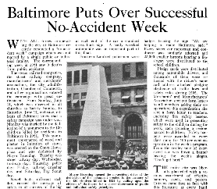
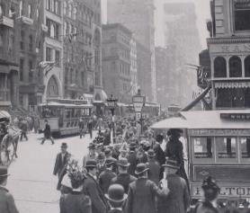
Active travel isn’t anything new
Images: National Safety News, 1921
https://www.thirteen.org/metrofocus/wp-content/blogs.dir/86/files/teddy-roosevelt/2-zeisloft-broadway2.jpg

Slide 7
Why Active Travel?
People in England travelled 6,554 miles and made 960 trips per year ***
77% of these miles travelled were by car***
Slightly more than half of journeys btw 1-2 miles are done by car *
49% of all journeys in England are < 5 miles *
Short car journeys cause more pollutants **
Walking and cycling rates in England have not changed significantly in 15 years *
Fewer than 2% of all journeys are done by bicycle *
* https://publications.parliament.uk/pa/cm201719/cmselect/cmtrans/1487/148705.htm
** https://www.ons.gov.uk/economy/environmentalaccounts/articles/fivefactsaboutcars/2016-09-22
***https://www.ethnicity-facts-figures.service.gov.uk/culture-and-community/transport/travel-by-distance-trips-type-of-transport-and-purpose/latest/

Slide 8
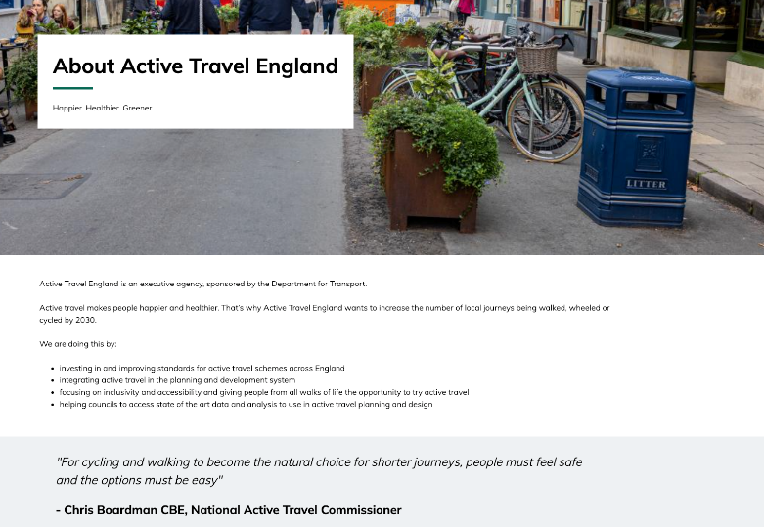
The push for active travel
https://www.activetravelengland.gov.uk/about

Slide 9
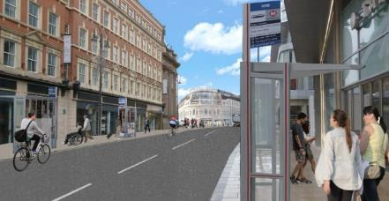
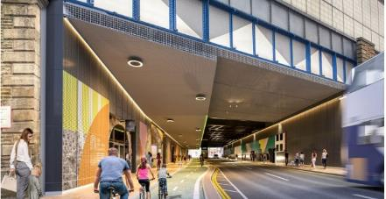
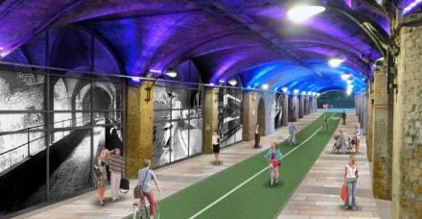
A normative, morally laden framework?
Making the decision to cycle is conditioned and embedded in wider sociocultural and material relations rather than merely being an individual choice.
-Balkmar, D., Henriksson, M. & Joelsson, T., (2025)
Images: https://thehootleeds.com/news/plans-for-transformation-of-leeds-city-centre-emerge-as-construction-work-begins/

Slide 10
Six Elements of a Politics of Mobility
By politics I mean social relations that involve the production and distribution of power.
By politics of mobility, I mean the ways in which mobilities are both productive of such social relations and produced by them.
-Cresswell, T. (2010). Towards a Politics of Mobility. Environment and Planning D, 28(1), 17-31 (p 21)
Class
Age
Religion
Gender
Ethnicity
Ability/Disability
Capitalism
Notes:
Politics are implicit in Norton, explicit

Slide 11
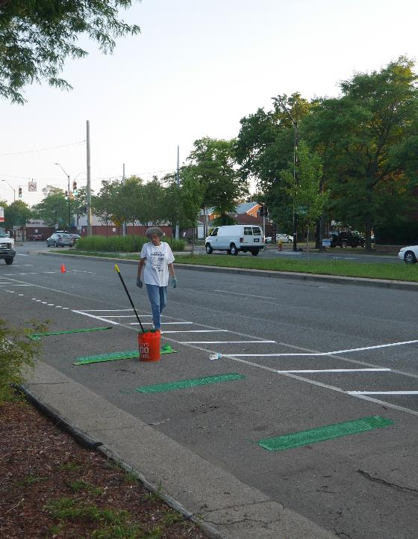
Mobility justice is for everyone
Mobility justice: goes beyond distribution to investigate implicit and explicit power relations/structures that determine what is value(d) in the broadest sense (see Sheller 2018)
It’s that white people in England travelled 6,878 miles per person per year – over 1,700 miles more than any other ethnic group *​
It’s that in the UK, households without cars tend have worse outdoor air quality AND those with 3 or more have better air quality too (Barnes, Chatterton & Longhurst 2019)
It’s about WWB (walking while Black)
It’s about challenging an implicit Ableism narrative within active travel and behaviour change narratives
It’s the reality that young people today will be most impacted by the automentality of the 20th century
*https://www.ethnicity-facts-figures.service.gov.uk/culture-and-community/transport/travel-by-distance-trips-type-of-transport-and-purpose/latest/​

Slide 12
A cornucopia of justices…
Distribution
Where and what infrastructure is being put in?
Epistemic |Participation |Recognition
Whose voice & knowledge counts?
Procedural
Standing up to profit making mobility “solutions”

Slide 13
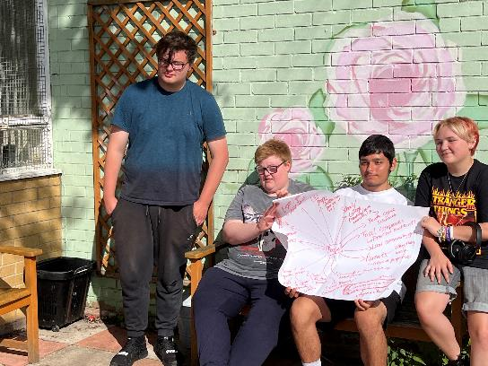
Epistemic |Participation |Recognition
Listening
Learning
Doing
Supporting

